Slide 1
MACHINE LEARNING-BASED FRAUD DETECTION IN HEALTHCARE INSURANCE WITH OPTIMIZED STORAGE IN BLOCKCHAIN USING ZERO-KNOWLEDGE PROOF
Project Review 2

Slide 2
Group 4
Arul Arasu N (Roll No: 20Z306)
Dhanaseelan V (Roll No: 20Z313)
Dinesh Baabu R (Roll No: 20Z315)
Lokajit G (Roll No: 20Z328)
Sudarshan S (Roll No: 20Z350)

Slide 3
Problem Definition

Slide 4
Problem Definition
In the insurance industry, the rise of fraudulent activities has become a significant concern, leading to financial losses for both insurers and legitimate policyholders. The main objective of this project is to develop an advanced system that utilizes a Machine Learning algorithm to effectively detect fake insurance claims while ensuring the secure storage of genuine transactions in a blockchain.

Slide 5
Literature Review

Slide 6
Literature Review
Abbas, K., Afaq, M., Ahmed Khan, T., & Song, W. (2020). A Blockchain and Machine Learning-Based Drug Supply Chain Management and Recommendation System for Smart Pharmaceutical Industry. Electronics.
Uses N-gram, LightGBM, Sentiment Analysis , Hyperledger Fabric.
Machine learning and blockchain technology integration.
The system provides secure and transparent drug supply chain management while also recommending the accurate medicines.
These results showcase the functionality and potential impact of the proposed system, highlighting its ability to provide drug recommendations and enhance the efficiency

Slide 7
Literature Review
Anokye Acheampong Amponsah, Adebayo Felix Adekoya, Benjamin Asubam Weyori, “A novel fraud detection and prevention method for healthcare claim processing using machine learning and blockchain technology”, Decision Analytics Journal, Volume 4, 2022, 100122, ISSN 2772-6622, https://doi.org/10.1016/j.dajour.2022.100122.
Serious problem causing economic losses to insurance and government.
Machine learning and blockchain technology integration
Decision tree classification algorithms for analysis
Reducing administrative costs and improving healthcare coverage
Challenges in real-world healthcare settings
Data privacy and security concerns
Resistance from healthcare providers and insurers

Slide 8
Literature Review
Shah, D., Patel, D., Adesara, J. et al. Integrating machine learning and blockchain to develop a system to veto the forgeries and provide efficient results in the education sector. Vis. Comput. Ind. Biomed (D.). Art 4, 18 (2021). https://doi.org/10.1186/s42492-021-00084-y
Uses Multiple Machine Learning models, Blockchain built from scratch
Machine learning and blockchain technology integration
Further additions like Use of existing blockchain technologies, reduction in time complexity for data retrieval can be made.

Slide 9
Literature Review
Sudeep Tanwar , Qasim Bhatia , PruthvI Patel, Aparna Kumari, Pradeep Kumar Singh and Wei-Chiang Hong” Machine Learning Adoption in Blockchain-Based Smart Applications: The Challenges,and a Way Forward“ https://ieeexplore.ieee.org/document/8938741/authors#full-text-header
This paper implies on the great immense technology of Blockchain and Machine Learning that would assist the several smart applications such as Unmanned Aerial Vehicle (UAV), Smart Grid (SG), healthcare, and smart cities.This raised common issues on many directing industry faces on security issues such as majority attack and double-spending. Data analytics is required on blockchain based secure data such that Machine Learning would be analyzed using tradition ML technique such as ,Support Vector Machines (SVM), clustering, bagging, and Deep Learning (DL) algorithms such as Convolutional Neural Network (CNN) and Long short-term memory (LSTM) can be used to analyze the attacks on a blockchain-based network.

Slide 10
Literature Review
Insurance Fraud Detection Using Novel Machine Learning Technique
Limitations of traditional fraud detection techniques
Proposal of a novel approach using eRFSVM hybrid classifier
Combination of Random Forest and Support Vector Machine algorithms
Exceptional accuracy of 97.176% in evaluating customer claims
Challenges of the proposed approach:
1.Data volume
2.New fraud types

Slide 11
Literature Review
ClaimChain: Secure Blockchain Platform for Handling Insurance Claims Processing
Introduction of ClaimChain as a secure blockchain platform
Integration of machine learning and NICB-identified red flags in fraud prevention
Detailed dataset analysis on ClaimChain testbed revealing patterns in fraudulent claims
Emphasis on potential benefits for the insurance industry
ClaimChain code is currently intended for research purposes only and may not be suitable for use in real-world systems.

Slide 12
Literature Review
“Detecting insurance claims fraud using machine learning techniques”
Takeaways
Set of rules and anomalies for creating raw data
Compare performance using Confusion matrix
Random forests and Decision Tree outperformed Naive Bayes

Slide 13
Literature Review
“Fraud Detection and Analysis for Insurance Claims using Machine Learning”
Takeaways
Large amount of dataset
Supervised and Unsupervised Algorithms
ML models vs. Traditional methods
Data privacy concerns and model maintenance

Slide 14
Literature Review
“Blockchain technology of fraud Detection and Risk Prevention in Insurance Industry”
Takeaway:
Customer and Customer participant for registering insurance creating new block in blockchain network
Validation process for insurance claim and submission claim
Results received to via smartphone or PC.

Slide 15
Literature Review
“Avoiding Insurance Fraud : A Blockchain-based Solution for the Vehicle Sector”
Takeaways :
Implementing S/W tools such as Truffle Framework, Solidity, Metamask, Ganache and Node.js.
Framework to implement the blockchain network.

Slide 16
Dataset

Slide 17
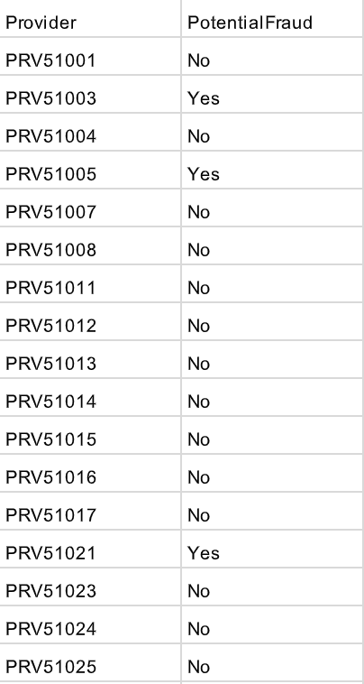
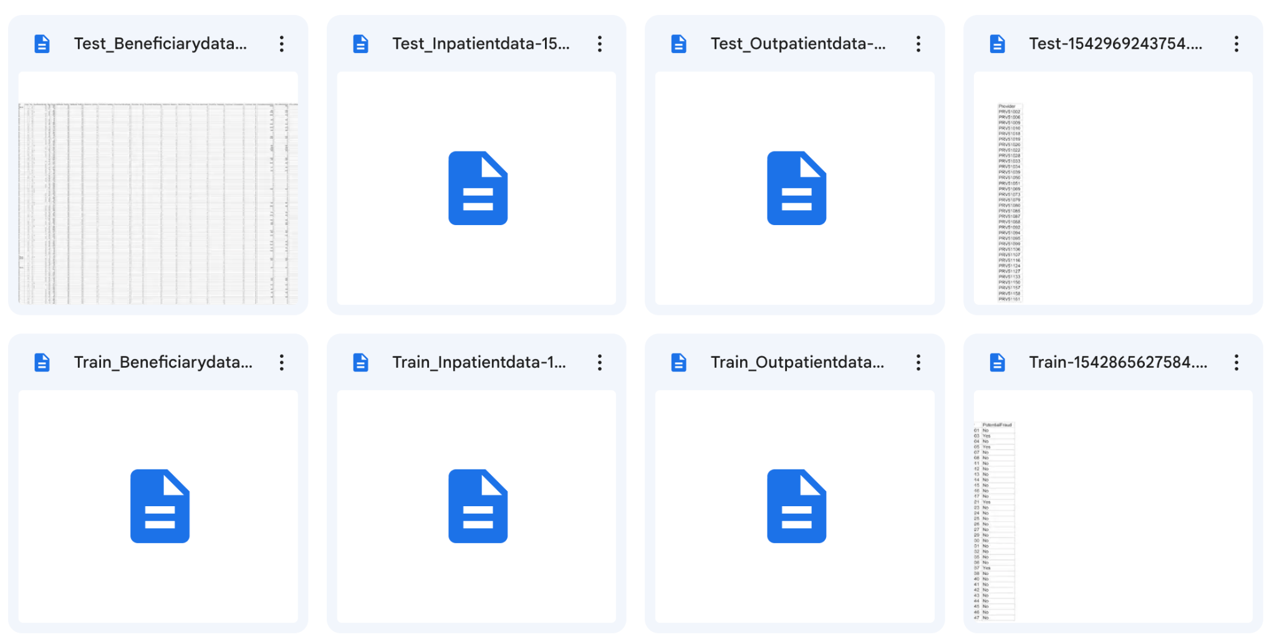
Dataset details

Slide 18
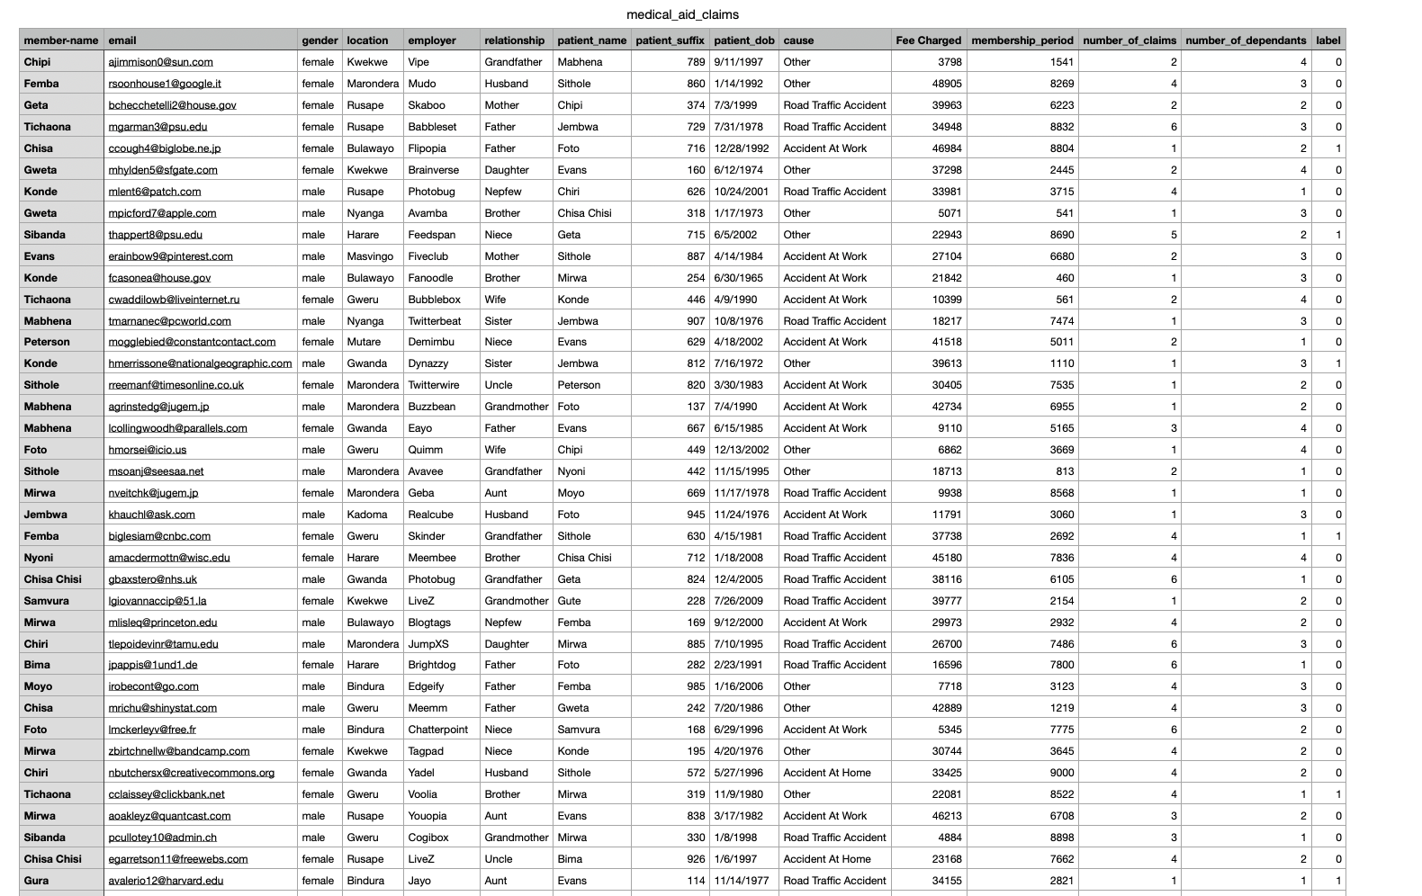

Slide 19
Object Oriented Analysis and Design

Slide 20
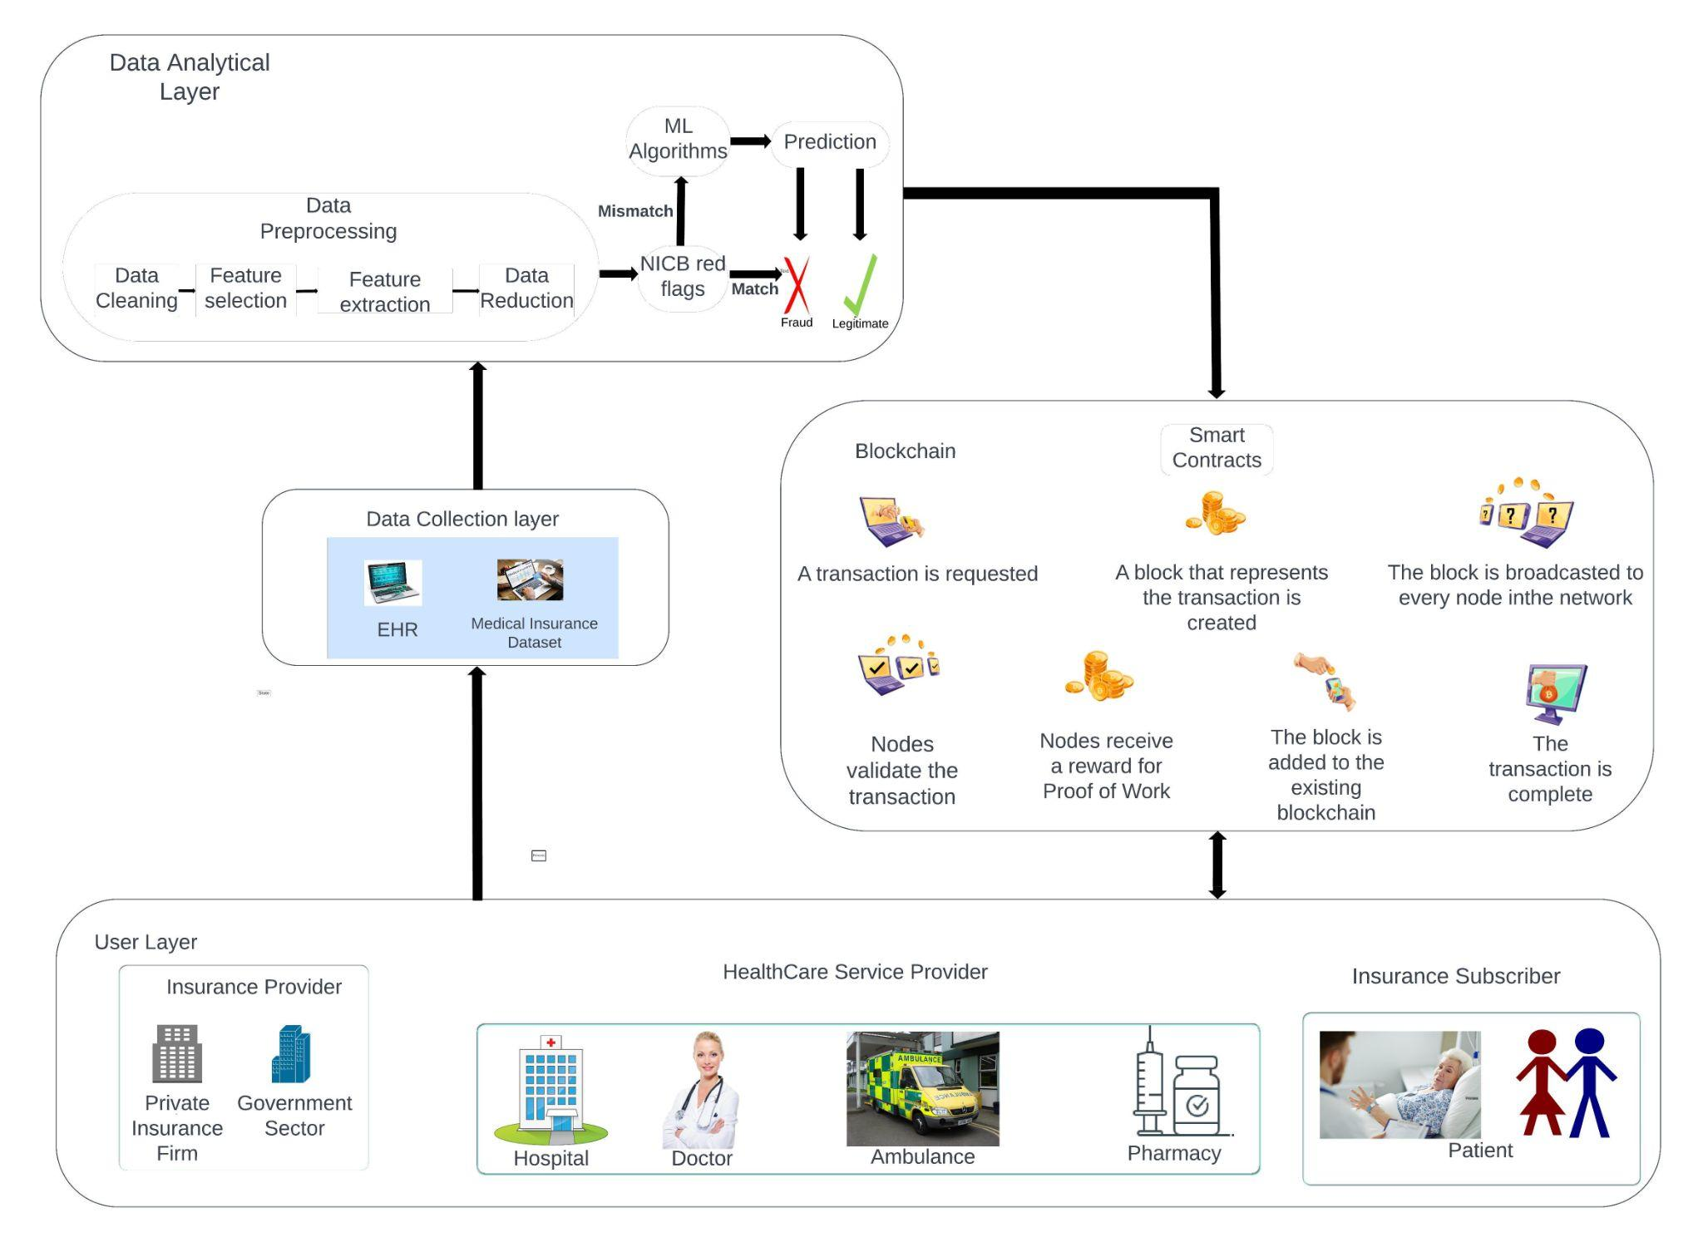

Slide 21
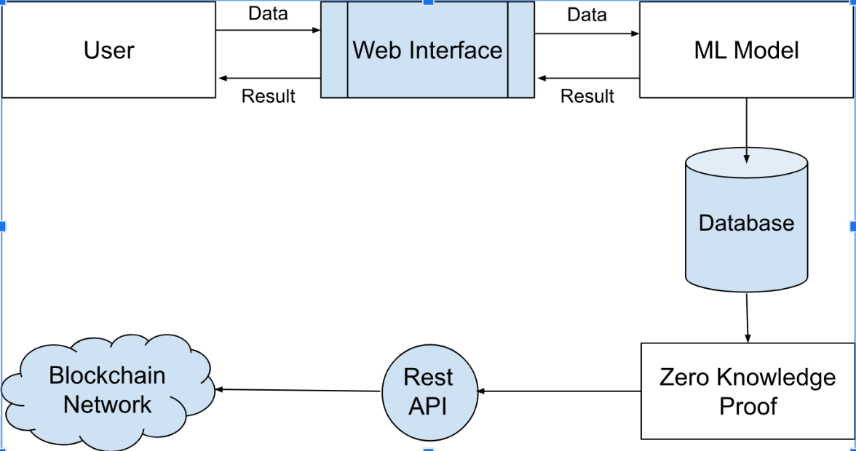

Slide 22
Implementation

Slide 23
Progress…
Hyperledger Fabric installation
Chaincode creation and deployment using channels
Basic query operations using Fabric Node SDK
Pickled model communicating output to Node.js application using Flask
User’s frontend interface

Slide 24
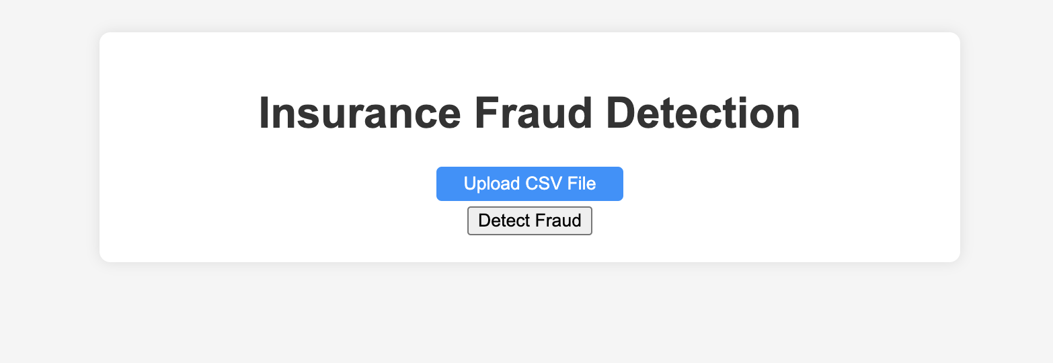
FRONT END UI FOR ACCEPTING CSV FILE FROM USER
`

Slide 25
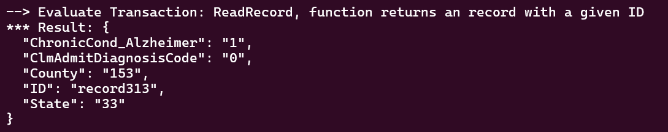
HYPERLEDGER FABRIC USING NODE.JS AND EXPRESS

Slide 26
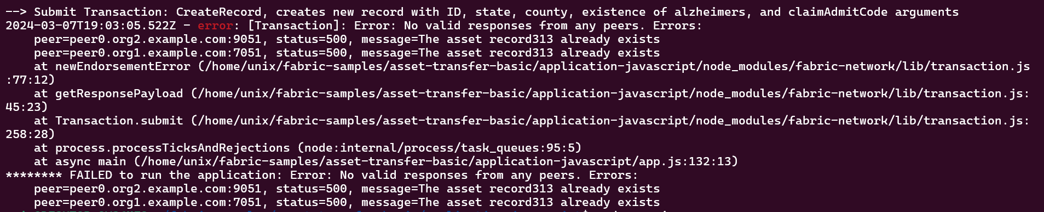
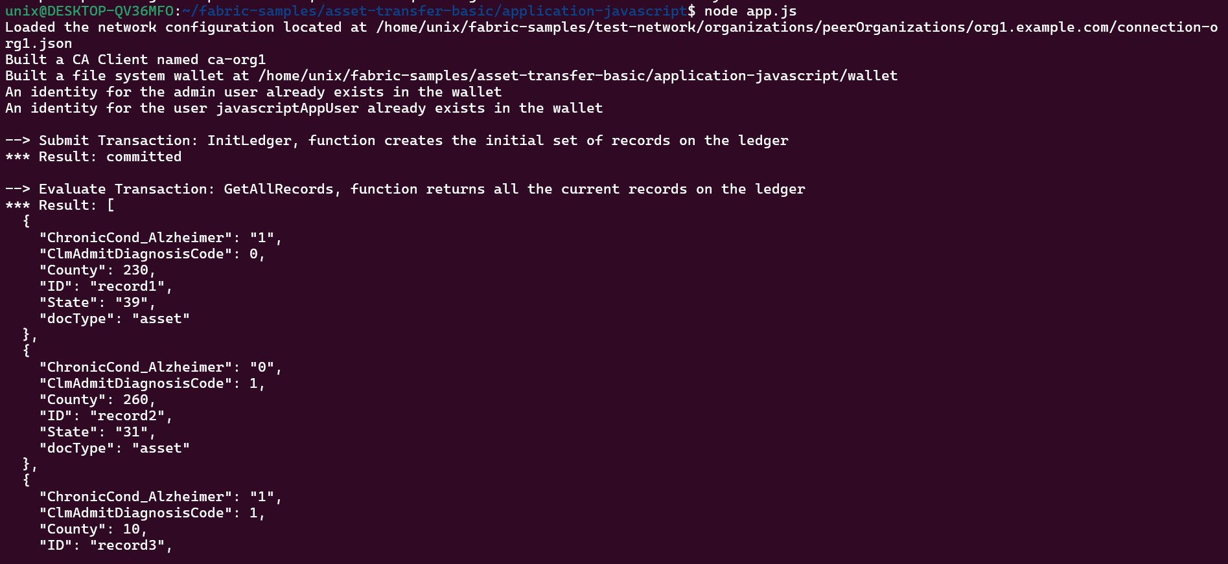

Slide 27
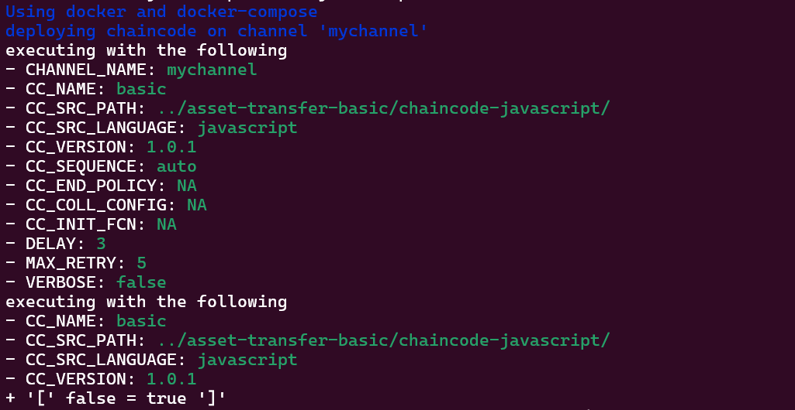
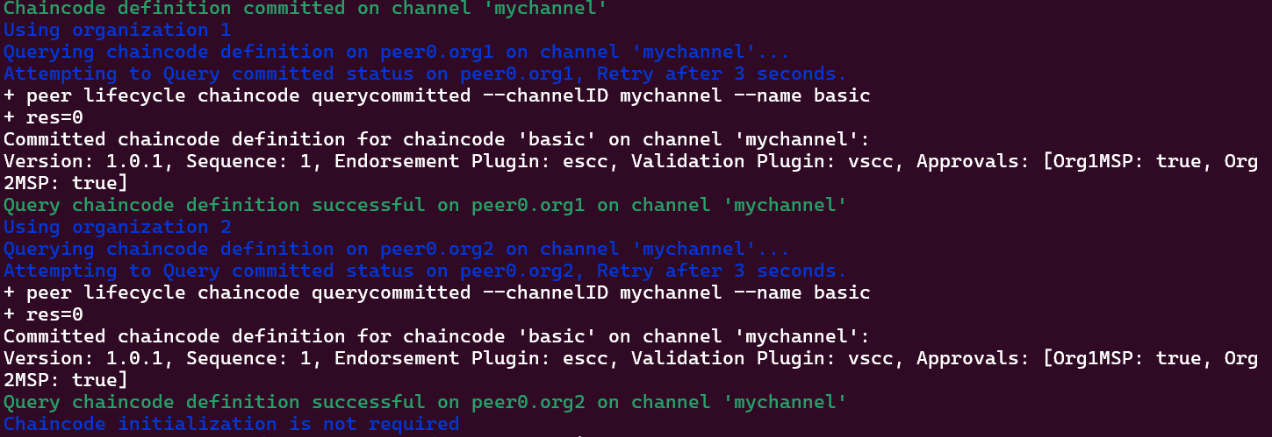
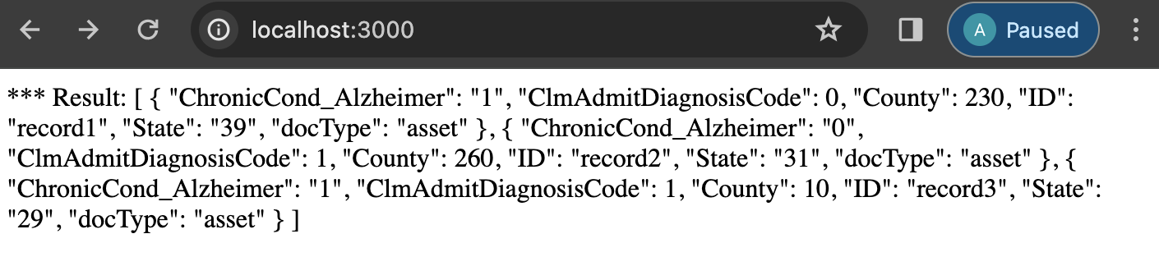
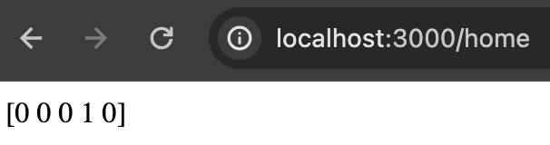

Slide 28
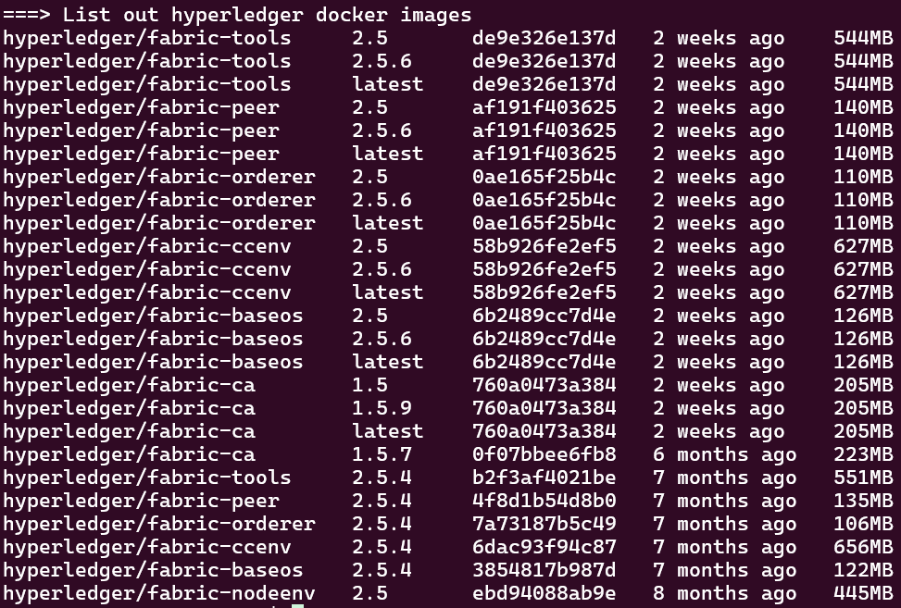
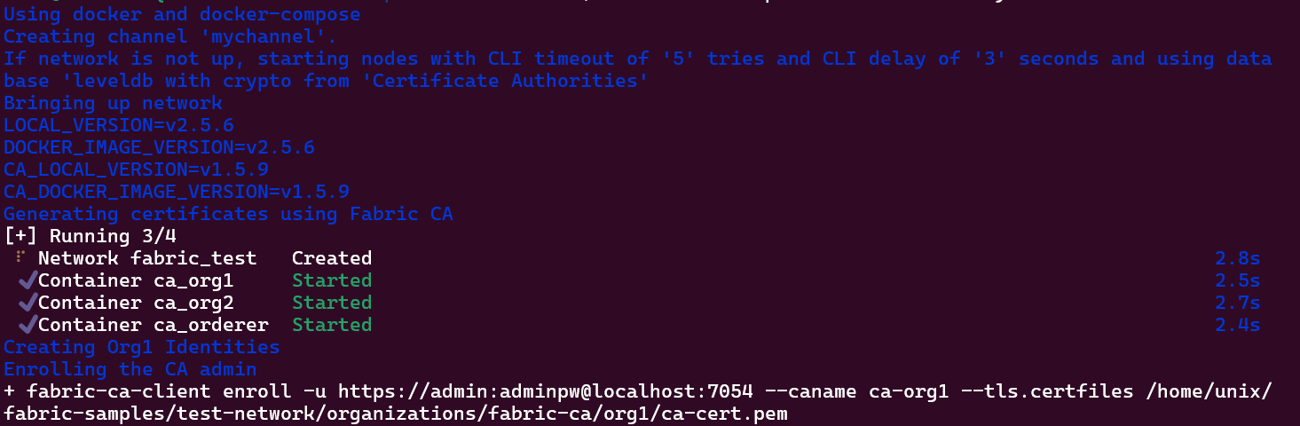
INSTALLATION OF HYPERLEDGER FABRIC AND FABRIC SDK

Slide 29
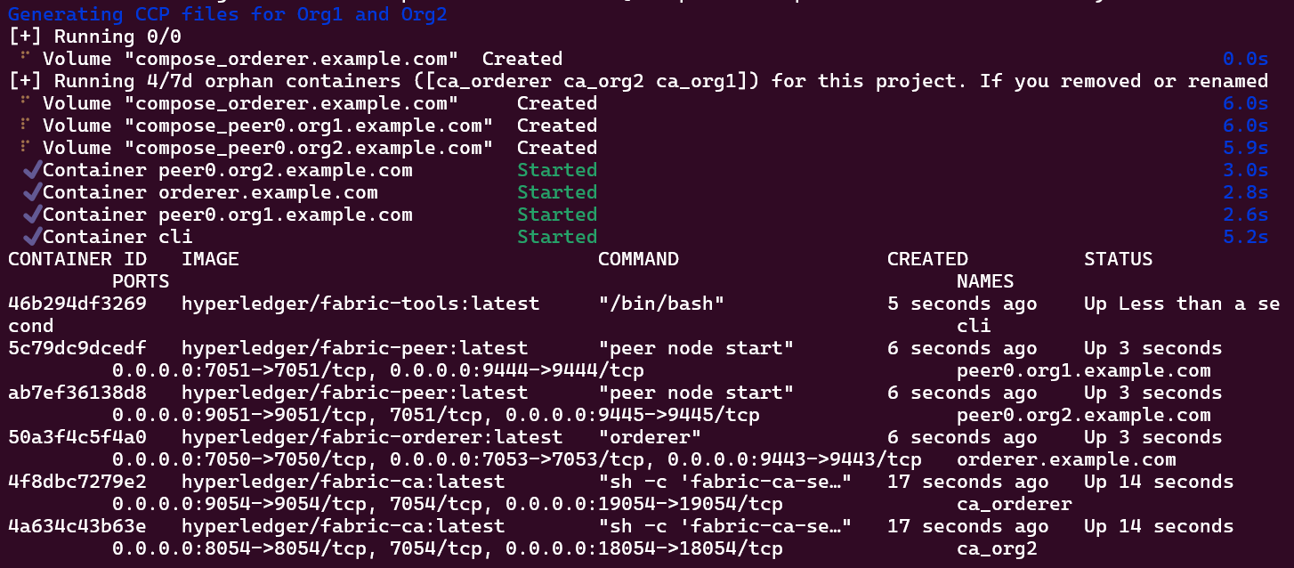

Slide 30
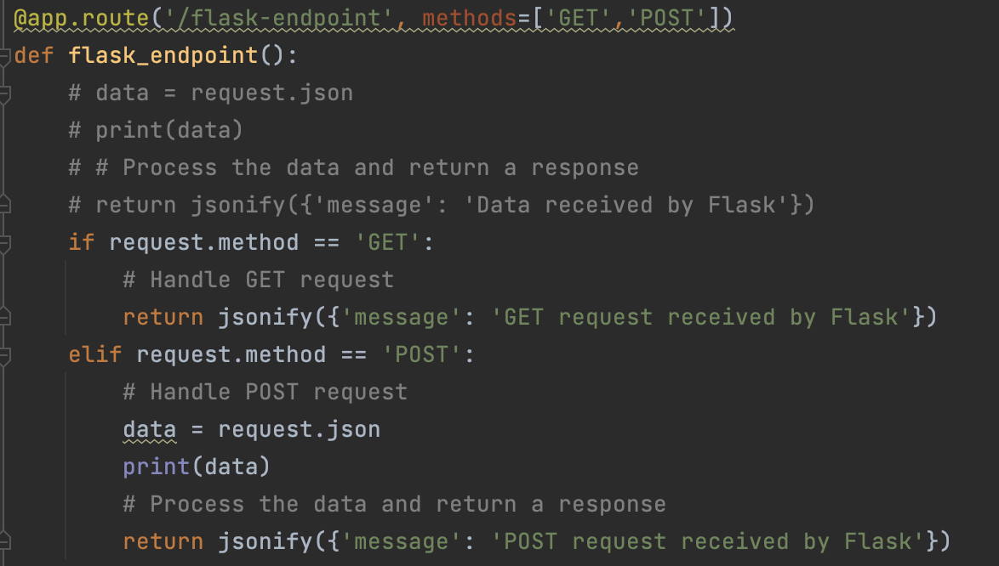
EXPOSING PRETRAINED MODEL USING FLASK

Slide 31
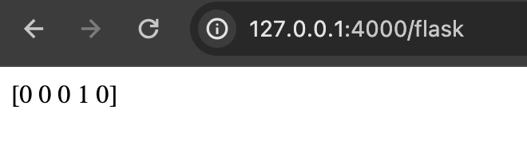

Slide 32
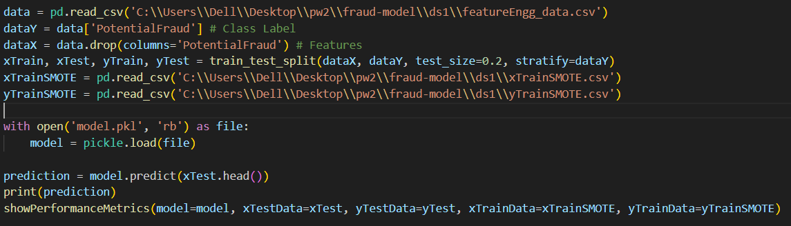
PICKLING THE MACHINE LEARNING MODEL

Slide 33
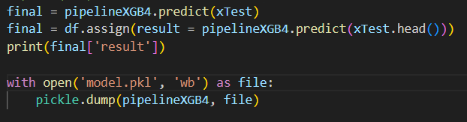

Slide 34
Future steps…
Find alternatives to the Flask API
Improvisation in the frontend part
Proper implementation and use of Zero Knowledge Proofs
Testing and Debugging

Slide 35


